Slide 1
First-Order Filters
Secton 14.4

Slide 2
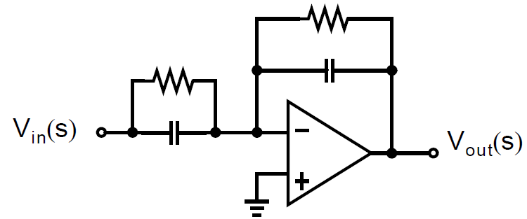
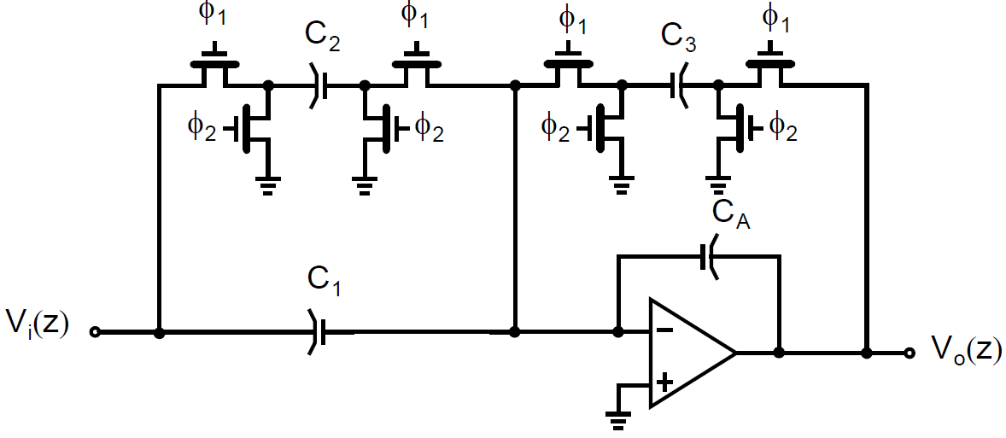
First-order Switched-capacitor Filter
Active RC Prototype
Switched-capacitor Equivalent
Fig. 14.17
Fig. 14.18(a)
Beginning with conventional continuous-time active RC filters, and replacing each resistor with a switched-capacitor results in a discrete-time filter whose frequency response closely approximates that of the original continuous-time filter at frequencies far below the sampling frequency

Slide 3
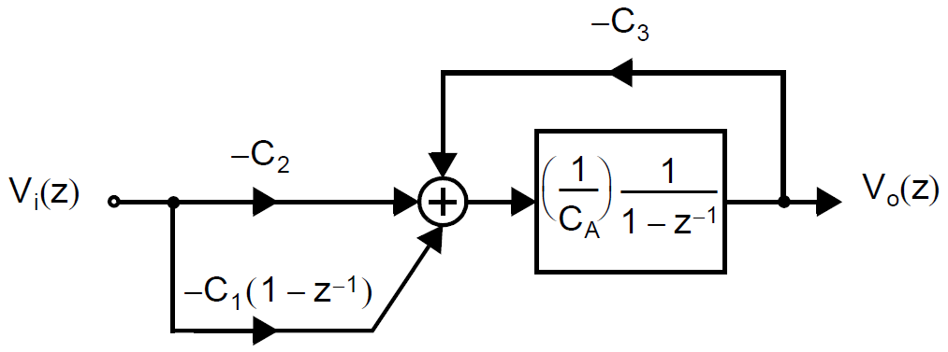
First-order Switched-capacitor Filter
Signal Flow Graph
Switched-capacitor Filter
Fig. 14.18(b)
Fig. 14.18(a)
Once a filter structure is obtained, its precise frequency response is determined through the use of discrete-time analysis

Slide 4
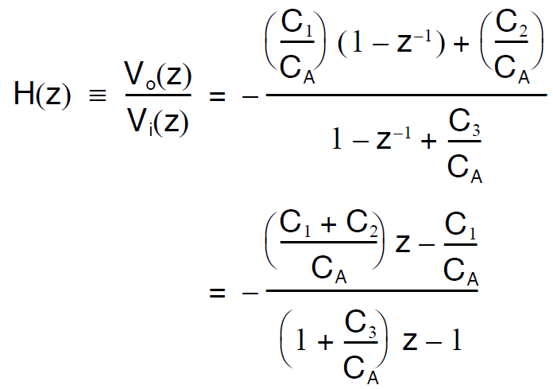
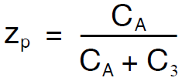
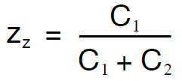
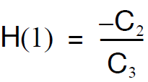
First-order Switched-capacitor Filter

Slide 5
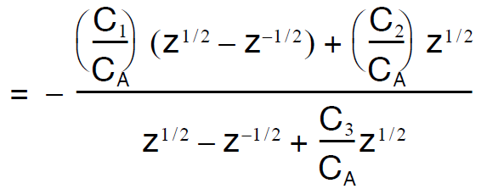
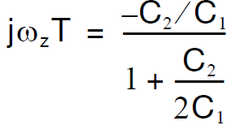
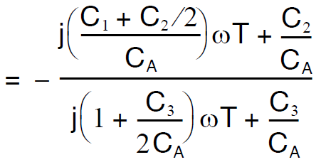
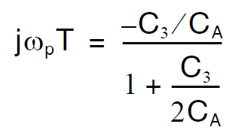
Frequency response of the first-order filter
Using:
&
ωT << 1 ⇒ ω << 1/T :

Slide 6
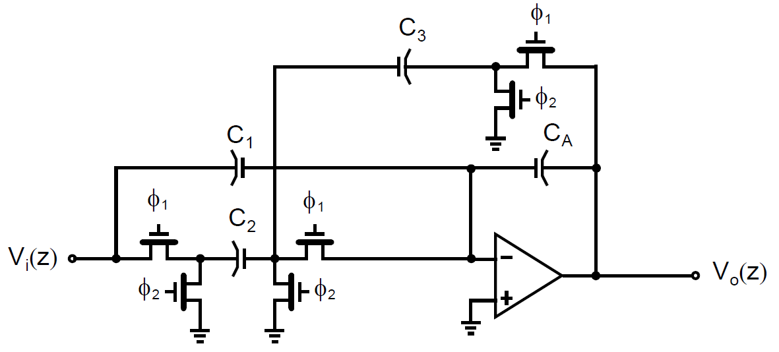
Switch Sharing
Fig. 14.18(a)
Fig. 14.19

Slide 7
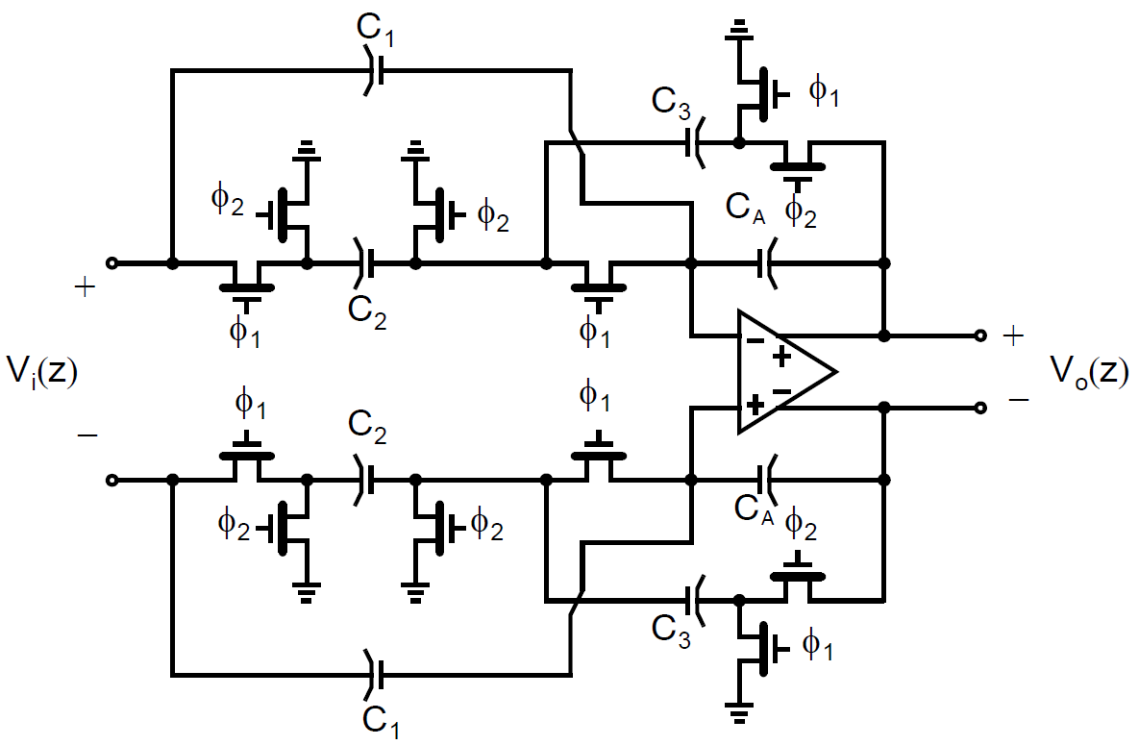
Fully Differential Implementation
Allows for signal inversion by crossing wires

Slide 8
Biquad Filters
Secton 14.5

Slide 9
Discrete-Time Biquad Realizations
Similar to continuous-time biquads, discrete-time biquads may be realized using two integrators in a negative feedback loop, one of the integrators having loss to provide stability
Several different discrete-time biquads can be realized by varying the type (i.e., delayed, delay-free) and exact connection of switched-capacitor branches within the two-integrator loop
The choice of which biquad to use depends upon the specific pole and zero locations sought.

Slide 10
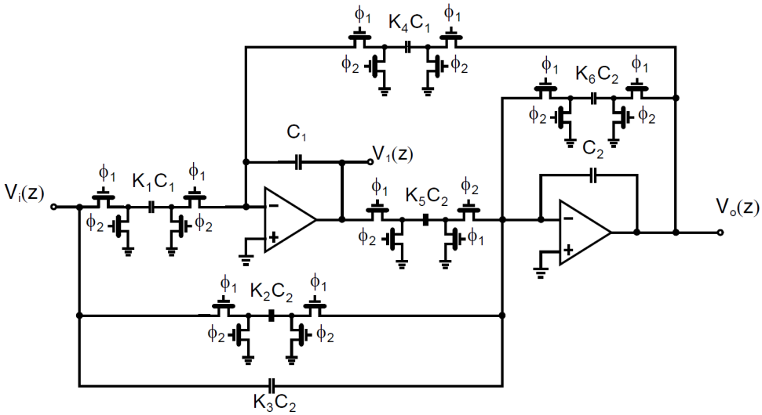
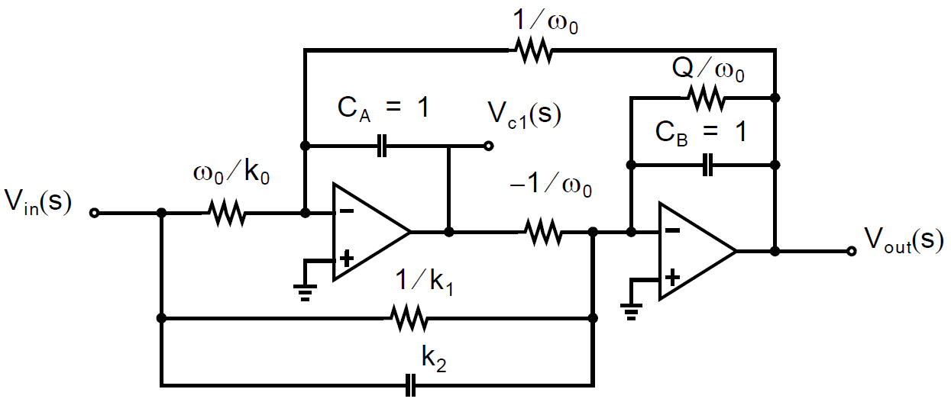
Biquad #1
Active RC Prototype
Switched-capacitor Equivalent

Slide 11
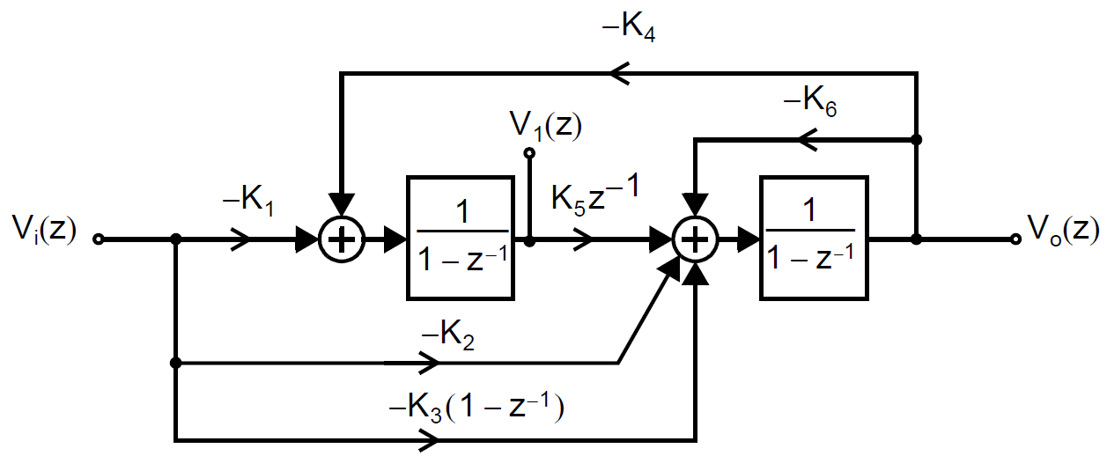
Biquad #1
Signal Flow Graph
Switched-capacitor Equivalent

Slide 12
Biquad #1 Transfer Function

Slide 13
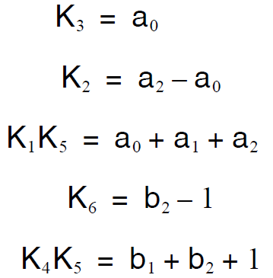
Biquad #1 Design Equations
Extra degree of freedom in choice of K₅ determines the amplitude of the signal at V₁.

Slide 14
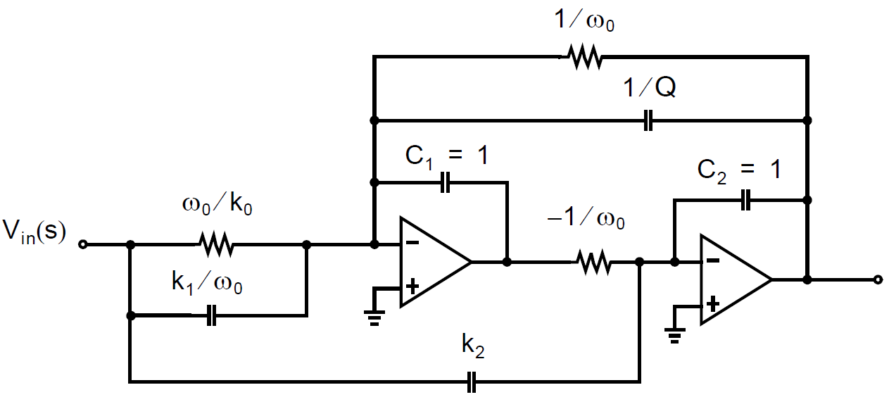
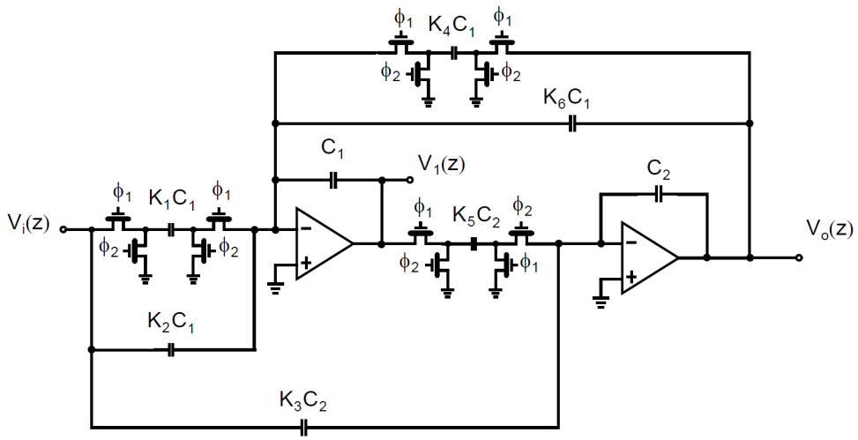
Biquad #2
Active RC Prototype
Switched-capacitor Equivalent

Slide 15
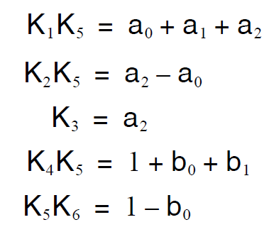
Biquad #2 Design Equations
Extra degree of freedom in choice of K₅ determines the amplitude of the signal at V₁.

